Slide 1

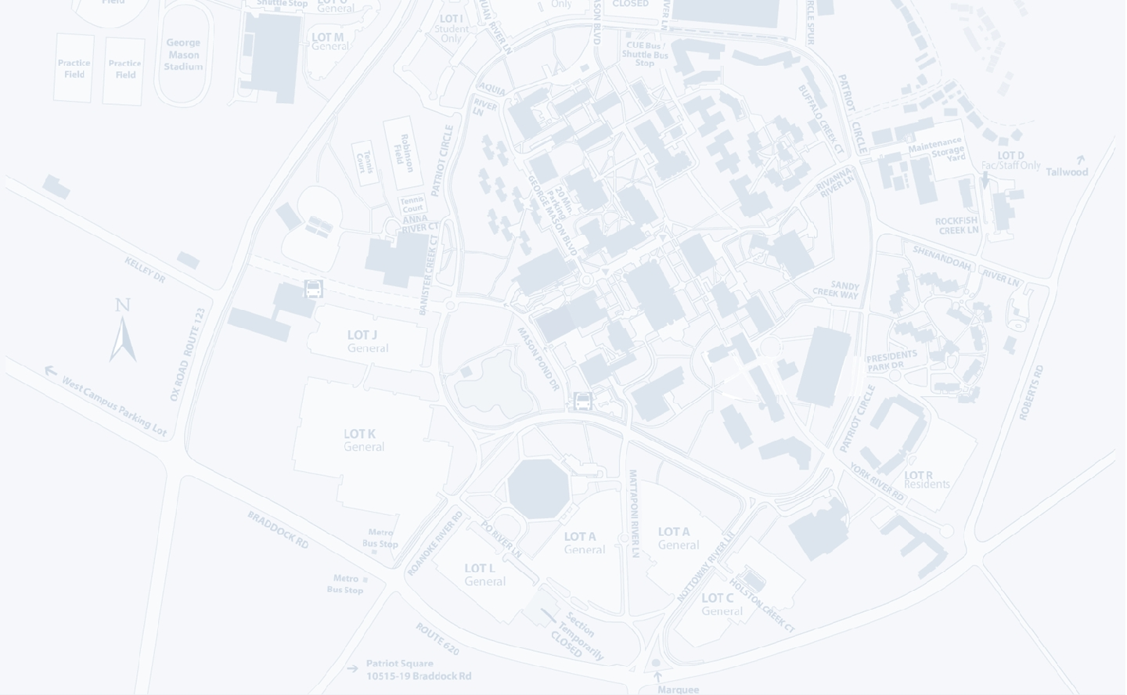
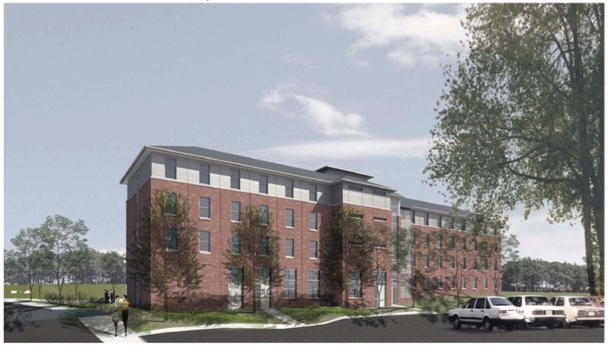

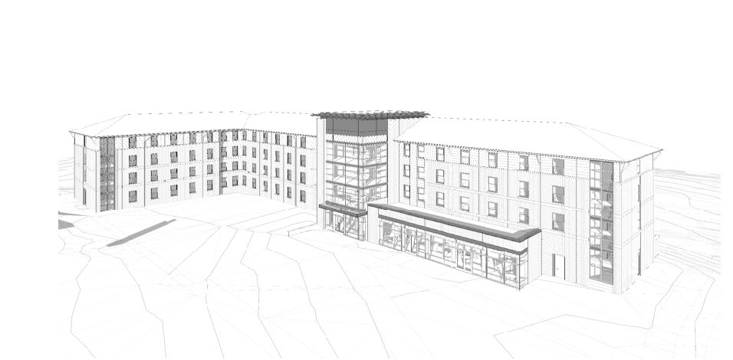
Taylor Hall
George Mason University
Bradley Williams - CM
Introduction
Prevention through Design
Façade Re-design for PtD
Stick-Built vs. Infinity System
Green Roof Addition
Conclusion
Acknowledgments
Fairfax, VA
Advisor: Ed Gannon
Renderings courtesy of Gensler

Slide 2
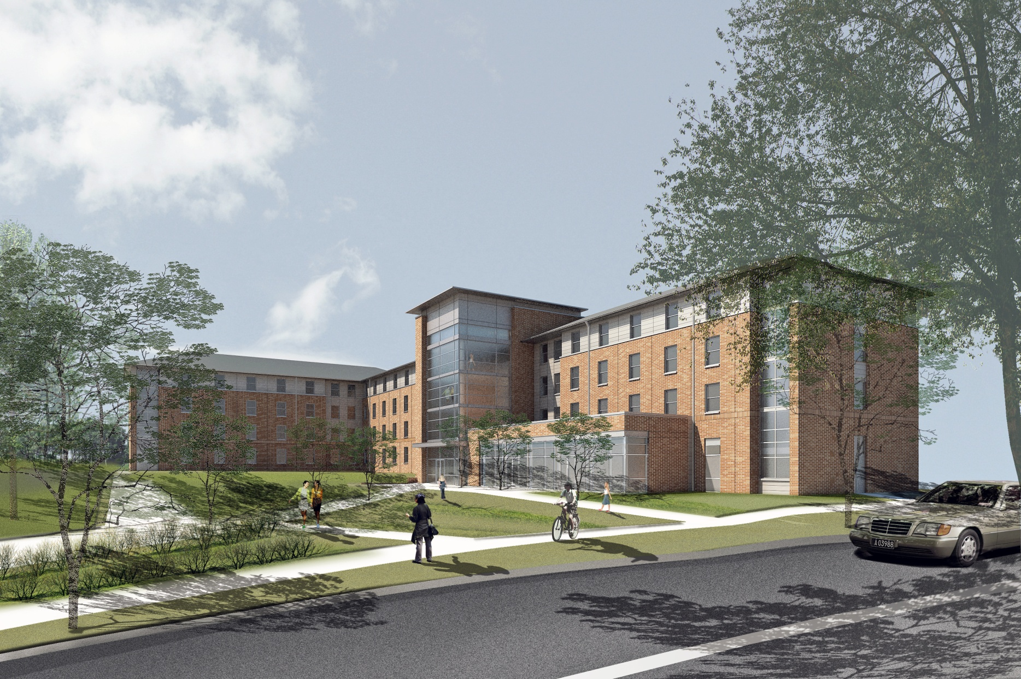

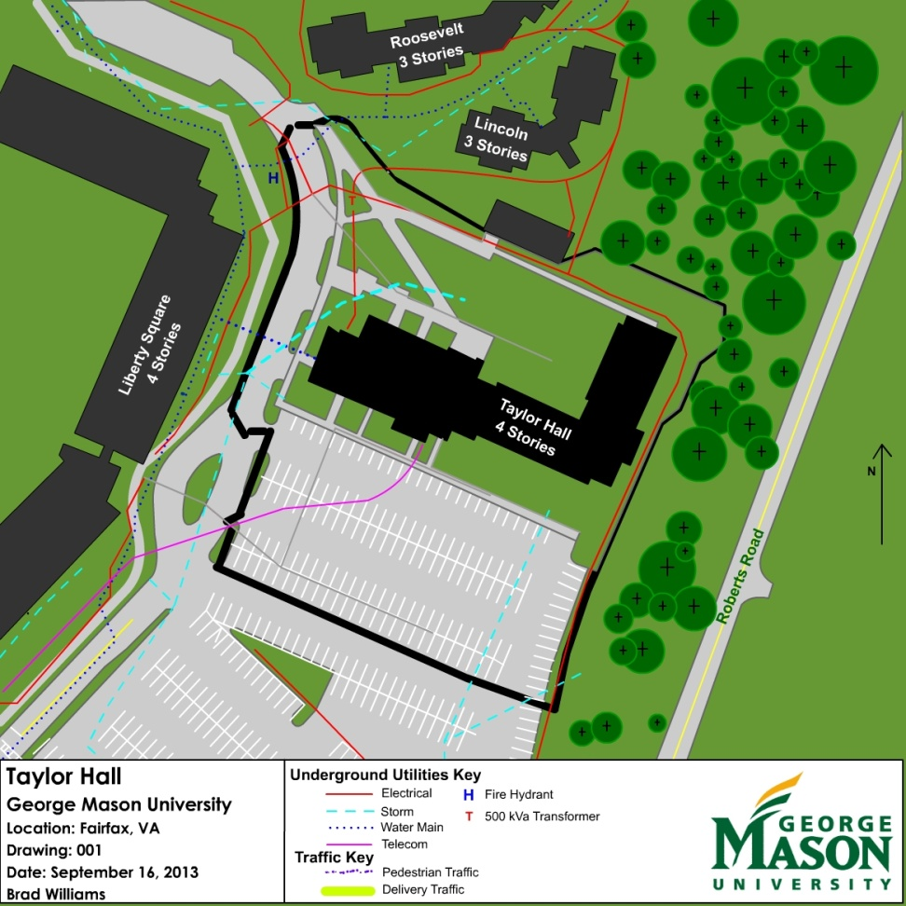


Taylor Hall – George Mason University
Fairfax, VA
Taylor Hall – George Mason University
Fairfax, VA
Bradley Williams - CM
Project Delivery – Design Build
Introduction
Prevention Through Design
Façade Re-design for PtD
Stick-Built vs. Infinity System
Green Roof Addition
Conclusion
Acknowledgments
Project Statistics:
295 Freshman Students
70,057 GSF
~$16,000,00
12 months of construction
LEED Silver
Owner
Design Builder
Architect
Design
Sub-contractors
Various
Sub-contractors
Renderings courtesy of Gensler

Slide 3
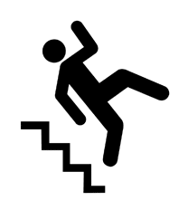

Taylor Hall – George Mason University
Fairfax, VA
Taylor Hall – George Mason University
Fairfax, VA
Bradley Williams - CM
Introduction
Prevention Through Design
Façade Re-design for PtD
Stick-Built vs. Infinity System
Green Roof Addition
Conclusion
Acknowledgments
Investigation Goals
Preview of Analyses
!
Analysis 1: Prevention through Design
Analysis 2: Façade Re-design for Fall Safety
Architectural Breadth: Mechanical Access Points
Analysis 3: Stick-Built construction vs. Infinity System
Analysis 4: Green Roof Addition
Structural Breadth: Green Roof Load incurrence
Investigate new ways to increase job-site safety
Reduce injury risk for construction workers, future students and maintenance personnel
$
Reduce the cost of construction while maintaining quality
Increase the awareness for sustainable design

Slide 4

Taylor Hall – George Mason University
Fairfax, VA
Taylor Hall – George Mason University
Fairfax, VA
Bradley Williams - CM
A N A L Y S I S O N E
Introduction
Prevention Through Design
Façade Re-design for PtD
Stick-Built vs. Infinity System
Green Roof Addition
Conclusion
Acknowledgments
Prevention through Design
Critical Industry Research
Ideas for Implementation
Raising sill height to 39”
Prefabrication
Raising parapet height and using flat roofs
Lowering mechanical access points
Using low VOC materials
Current Industry-Wide Issues
Lack of risk knowledge
Lack of early collaboration/communication
Lack of contractual obligation for safety
Construction
Maintenance
Decommissioning
Disposal / Recycling
“…the Center for Disease Control and Prevention (CDC) have pinpointed in recent studies that an abundant 37% of these work related injuries are directly caused by poor design” - CDC.gov
Balfour Beatty Construction

Slide 5
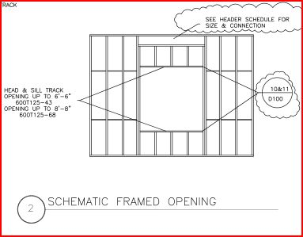
Taylor Hall – George Mason University
Fairfax, VA
Taylor Hall – George Mason University
Fairfax, VA
Bradley Williams - CM
A N A L Y S I S T W O
Introduction
Prevention Through Design
Façade Re-design for PtD
Architectural Breadth
Stick-Built vs. Infinity System
Green Roof Addition
Conclusion
Acknowledgments
Façade Re-design and Implementation of Prevention through Design
Results:
Increase job site safety
Prevent student misconduct
Benefits outweigh cost
Save cost on temporary fall protection lines
Logical Safety improvement method given prefab structural system
Total cost of implementation:
No schedule impact
$17,156.40
39 in.
Renderings courtesy of Gensler

Slide 6
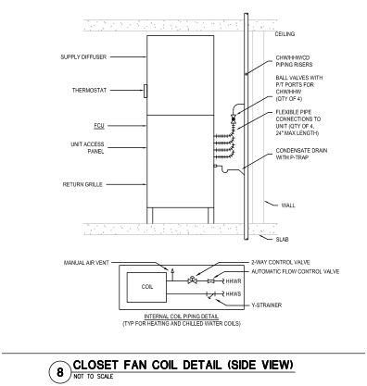
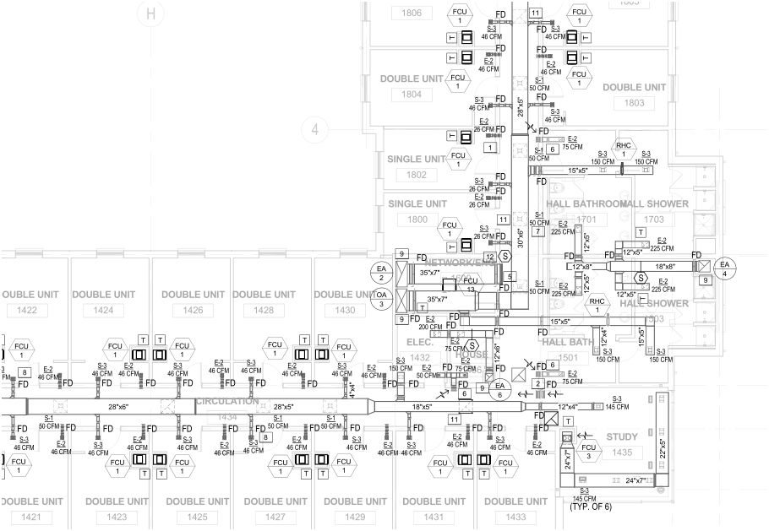
Taylor Hall – George Mason University
Fairfax, VA
Taylor Hall – George Mason University
Fairfax, VA
Bradley Williams - CM
A R C H I T E C T U R A L B R E A D T H
Introduction
Prevention Through Design
Façade Re-design for PtD
Architectural Breadth
Stick-Built vs. Infinity System
Green Roof Addition
Conclusion
Acknowledgments
Investigation of Mechanical Access Points
Mechanical Access Heights
Mechanical Room | Floor Mounted Equipment
Unit FCU Access | 3’ 5”
Mechanical Penthouse | 7’ 8”
8’ 6”
3’ 5”
All access points considered safe (except trip hazard in pent house)
All access points behind locked doors or restricted access
Considered very “safe” design
FCU Access points in each unit
Renderings courtesy of Gensler

Slide 7
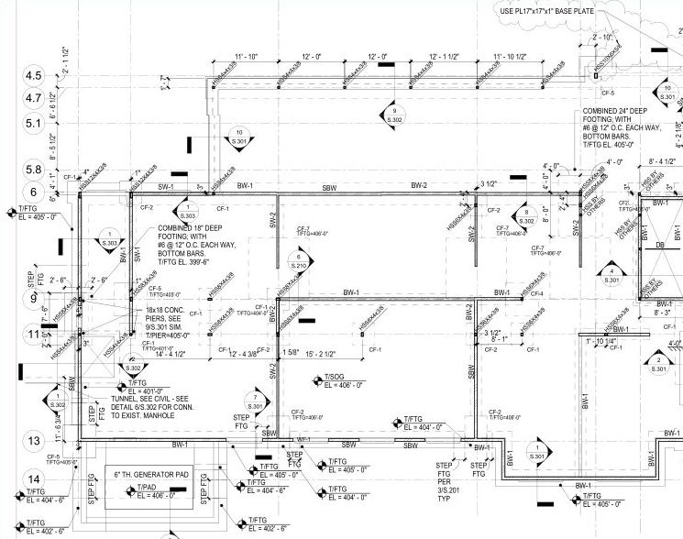
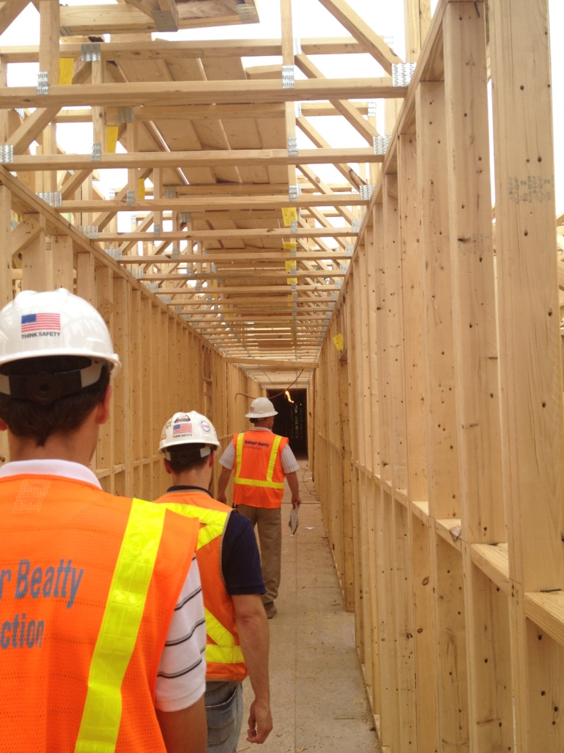
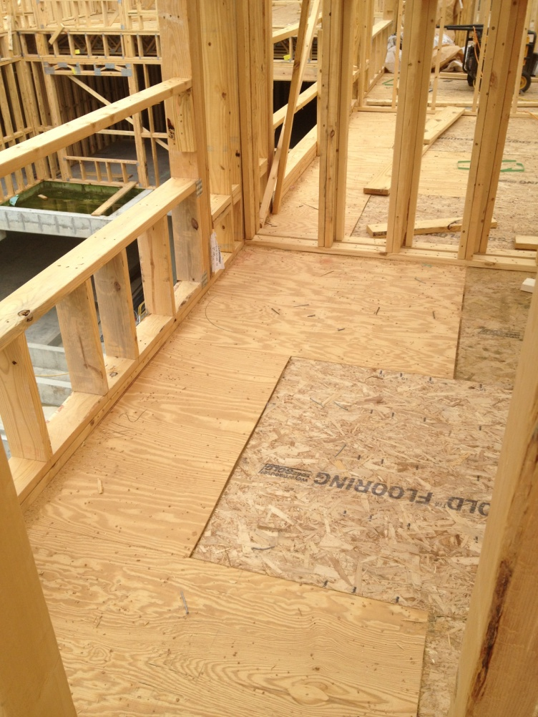
Taylor Hall – George Mason University
Fairfax, VA
Taylor Hall – George Mason University
Fairfax, VA
Bradley Williams - CM
A N A L Y S I S T H R E E
Benefits
Introduction
Prevention Through Design
Façade Re-design for PtD
Stick-Built vs. Infinity System
Green Roof Addition
Conclusion
Acknowledgments
No schedule change with prefabrication
Fire safe construction
Experienced craftsmen in D.C. area
Stick-Built Framing vs. Infinity Structural System
Overall Cost of Stick-Built System
Part of System | Price
Wooden Roof Trusses/Sheathing | $128,240.64
Wooden Framing | $612,998.75
Wooden Joists/Girders | $1,224,596.36
TOTAL COST | $1,965,835.75
Total ($/SF) | $28.06
Location Adjustment Multiplier (78.3) | $21.97
Infinity Structural System estimated at $23 / SF
Renderings courtesy of Gensler
Total Savings of $72,158.71
Photos courtesy of Brad Williams

Slide 8
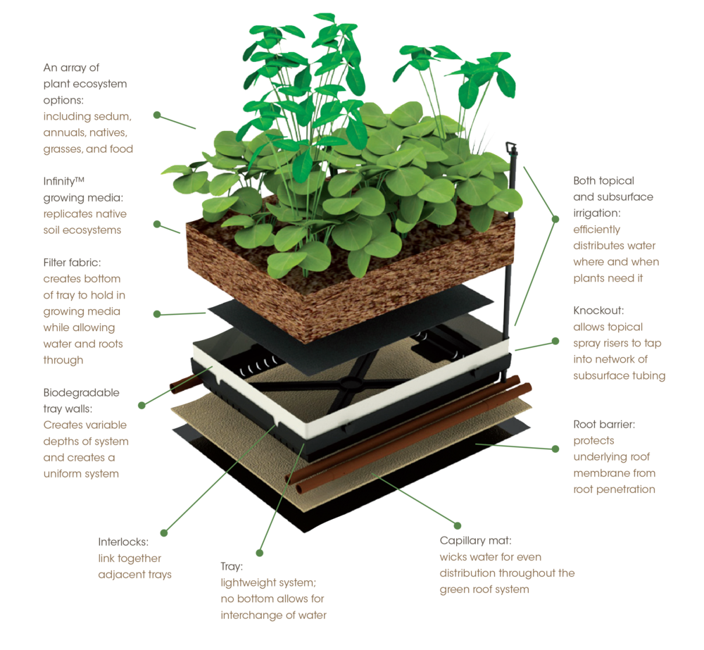
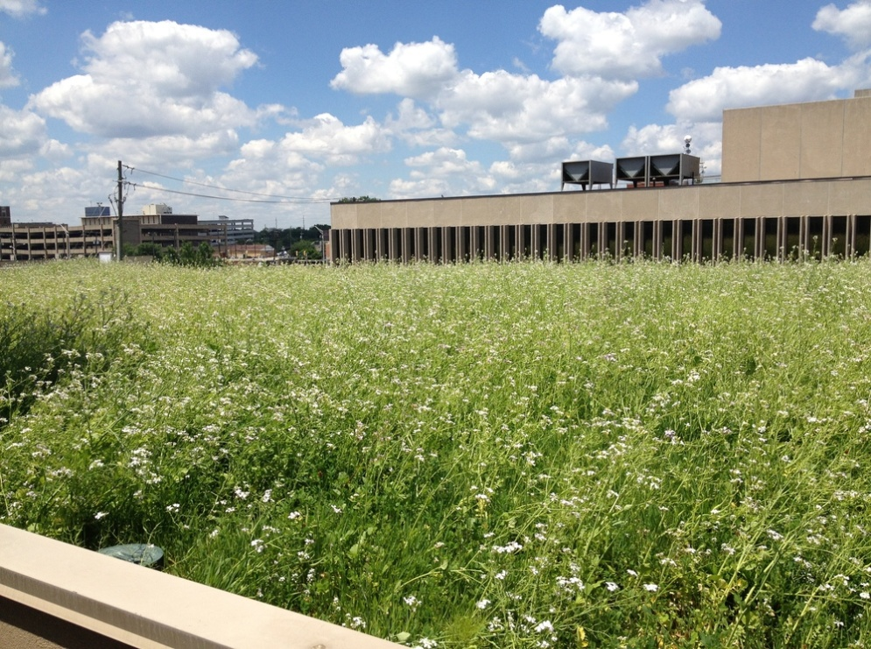
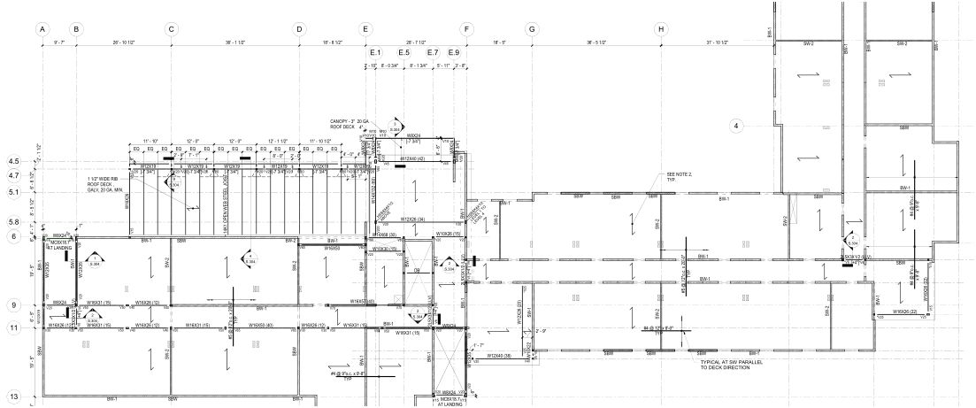
Taylor Hall – George Mason University
Fairfax, VA
Taylor Hall – George Mason University
Fairfax, VA
Bradley Williams - CM
A N A L Y S I S F O U R
Green Roof Addition
Introduction
Prevention Through Design
Façade Re-design for PtD
Stick-Built vs. Infinity System
Green Roof Addition
Structural Analysis
Conclusion
Acknowledgments
Multi-purpose Room Green Roof
Fiscal Analysis
Payback Period: 4.17 - 6.7 years
Internal Rate of Return*: 4.21%
Return on Investment*: 196%
Installation Cost of $17,696.63
1 day installation
Green Roof
50 – year Life Cycle Cost Benefit Analysis ($/SF)
Initial Cost | $13.51
Maintenance and Replacement | $18.25
Storm Water Reduction Savings | $11.37
Energy Savings | $6.37
CO2 Emission Savings | $2.60
Community Benefits | $30.90
Property Re-sale value premium | $105.93
* Not including CO2 Emissions, Community Benefits, or Re-Sale Value
1,310 SF total
Omni-Ecosystem comprehensive style green roof for optimum weight
Can be added post-construction
Low maintenance, high efficiency
Omni-Ecosystems.com
Takeaways
Significantly longer life than T.P.O.
Educational opportunities in sustainability
Lifetime net yield of up to $182,000 of benefits

Slide 9
Taylor Hall – George Mason University
Fairfax, VA
Taylor Hall – George Mason University
Fairfax, VA
Bradley Williams - CM
S T R U C T U R A L B R E A D T H
Introduction
Prevention Through Design
Façade Re-design for PtD
Stick-Built vs. Infinity System
Green Roof Addition
Structural Analysis
Conclusion
Acknowledgments
Structural Evaluation of Potential Green Roof
Structural Change
Load Comparison
Load Path of Green Roof
Member | Existing Load | New Load | Allowable
Roof Deck | 81 PSF | 99 PSF | 159 PSF
Joists | 329.2 PLF | 401.2 PLF | 472 PLF
Girder | 3.2 kips | 3.9 kips | 20 kips
Steel Post Column | 3.2 kips | 3.9 kips | 16 kips
HSS Column | 9.2 kips | 11.3 kips | 87 kips
Soil | 0.56 KSF | 0.71 KSF | 2.0 KSF
Existing Factored Load: 81 PSF
Factored Load with Green Roof: 99 PSF
W12X19
Girder
HSS 4x4x3/8
Column
1.5” 20 GA
galv. Roof Deck
14K1 Series
Joists
3 ksi concrete
footing
3” Steel Pipe
Column
15 PSF
All structural members can safely accommodate new loading
No structural changes are necessary

Slide 10

Taylor Hall – George Mason University
Fairfax, VA
Taylor Hall – George Mason University
Fairfax, VA
Bradley Williams - CM
Introduction
Prevention Through Design
Façade Re-design for PtD
Stick-Built vs. Infinity System
Green Roof Addition
Conclusion
Acknowledgments
Conclusion
Summary of Results
Analysis | Result
Prevention through Design | Reduced risk of injury over the building’s life
Façade Re-design | More efficient fall safety measures
Stick-Built Construction | Cost effective solution for the D.C. area
Green Roof Addition | Educational opportunities and financial benefits
$
Renderings courtesy of Gensler
!

Slide 11

Taylor Hall – George Mason University
Fairfax, VA
Taylor Hall – George Mason University
Fairfax, VA
Bradley Williams - CM
Introduction
Prevention Through Design
Façade Re-design for PtD
Stick-Built vs. Infinity System
Green Roof Addition
Conclusion
Acknowledgments
Acknowledgments
Family and Friends
John Risley, Contractor Safety Coordinator of PSU OPP
Professors and Faculty of the Architectural Engineering department
Questions?
Renderings courtesy of Gensler

Slide 12
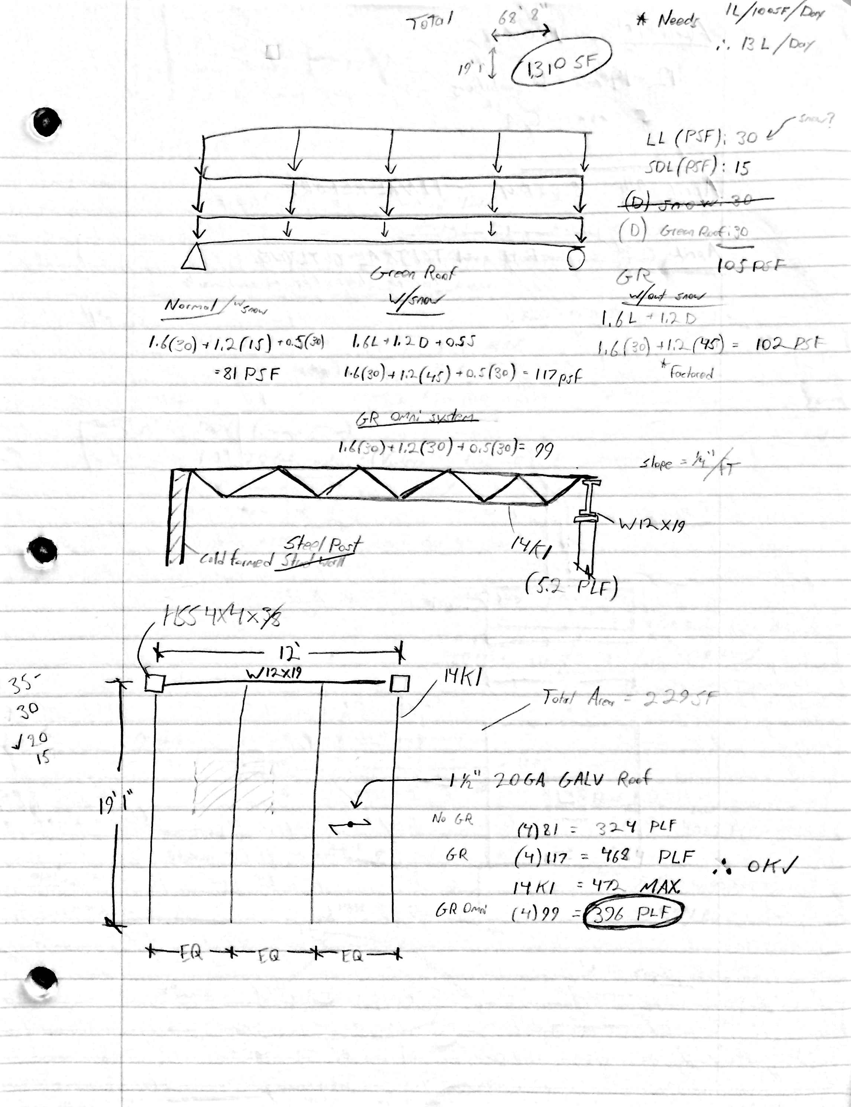
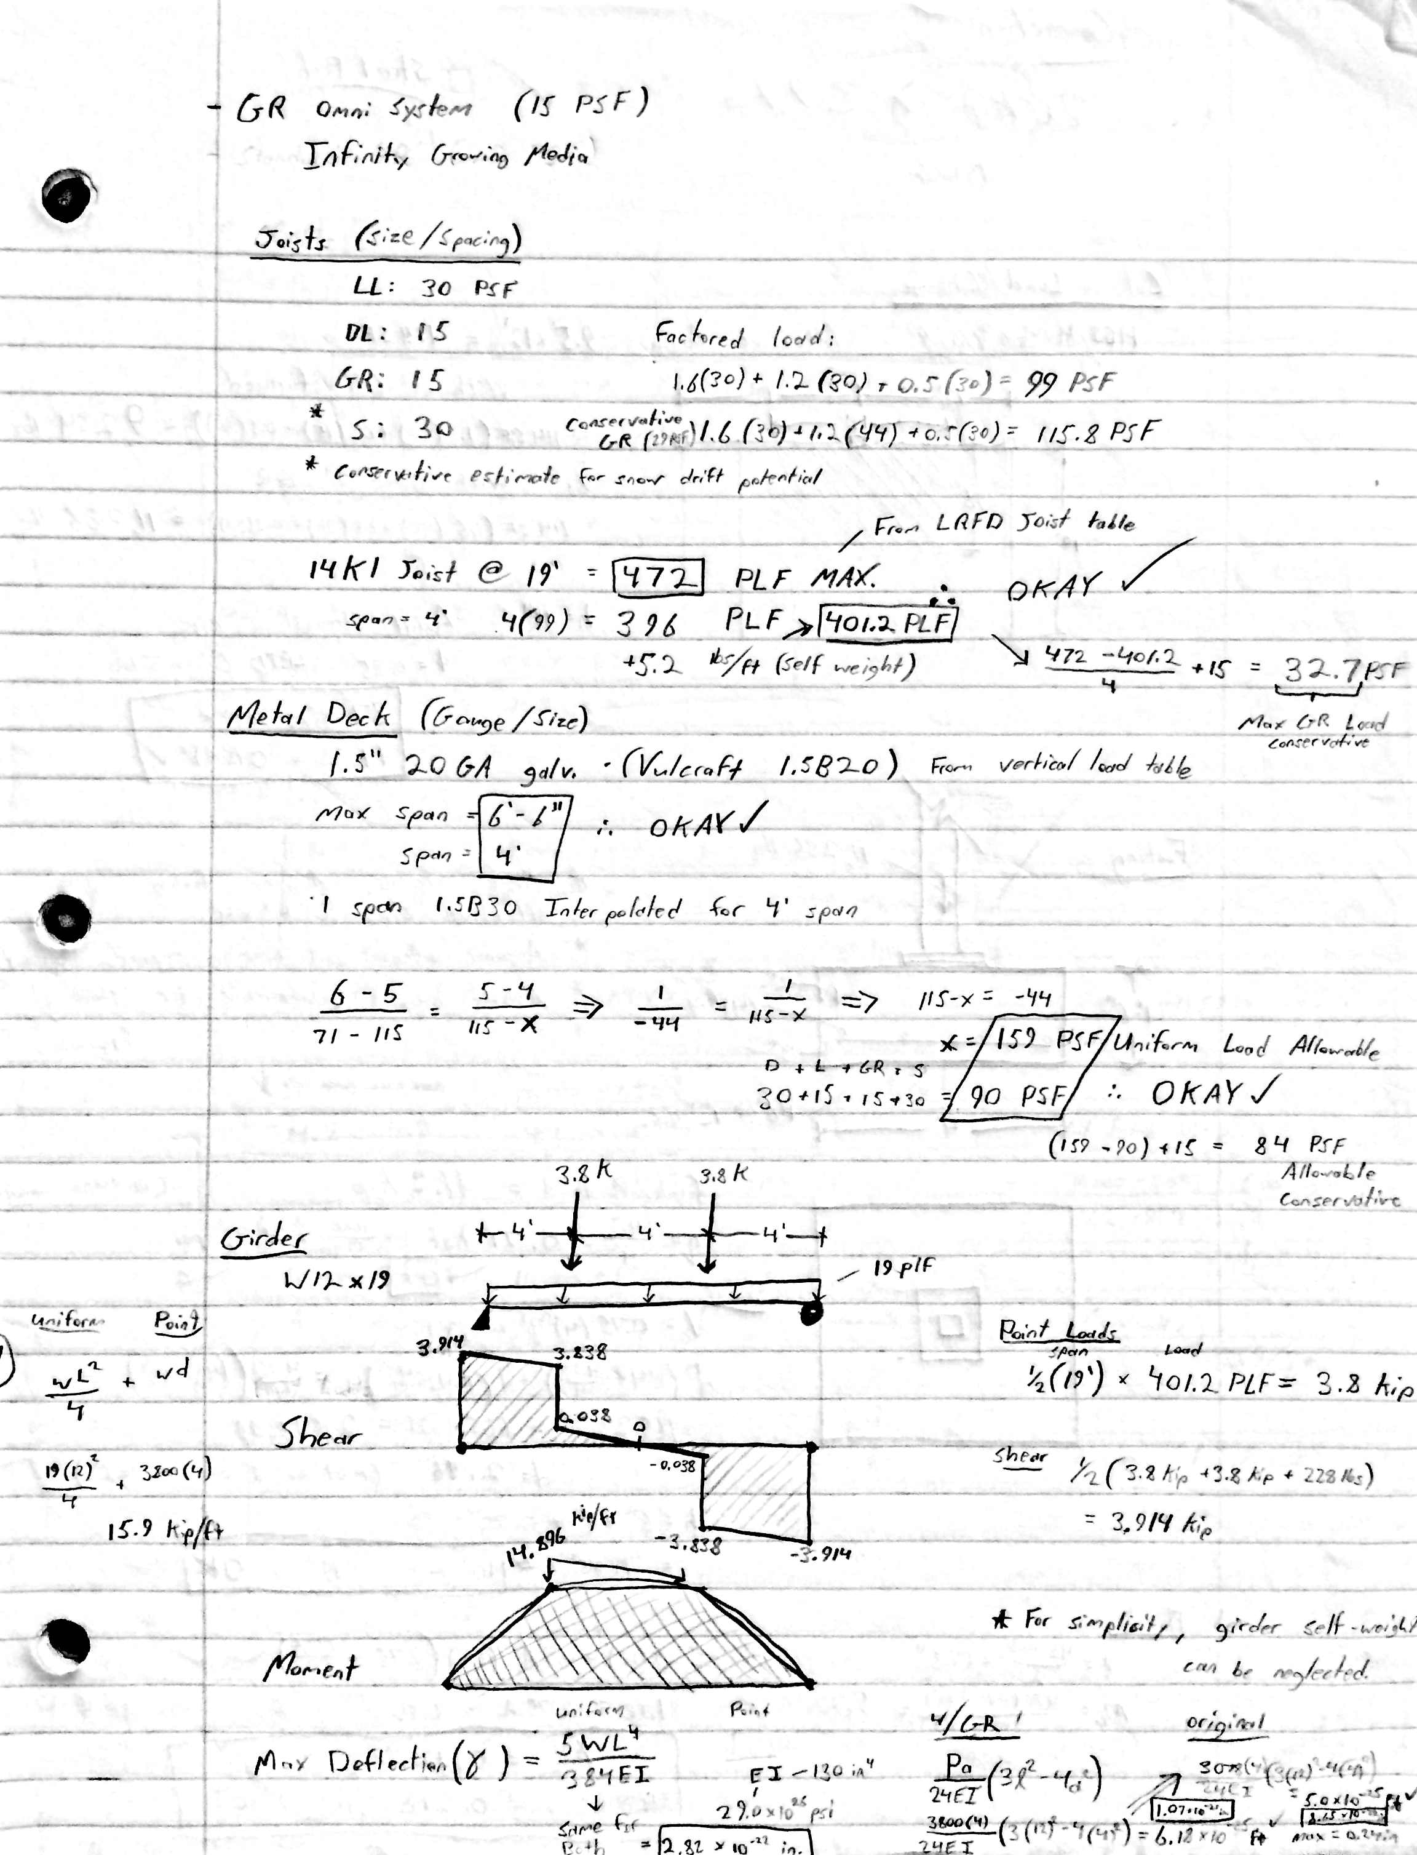
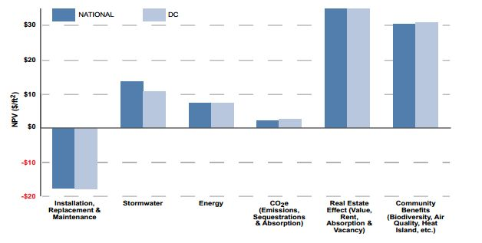
Appendix
Taylor Hall – George Mason University
Fairfax, VA
Taylor Hall – George Mason University
Fairfax, VA
Bradley Williams - CM
Introduction
Prevention Through Design
Façade Re-design for PtD
Stick-Built vs. Infinity System
Green Roof Addition
Conclusion
Acknowledgments
Green Roof Study conducted by the U.S. General Services Administration

Slide 13
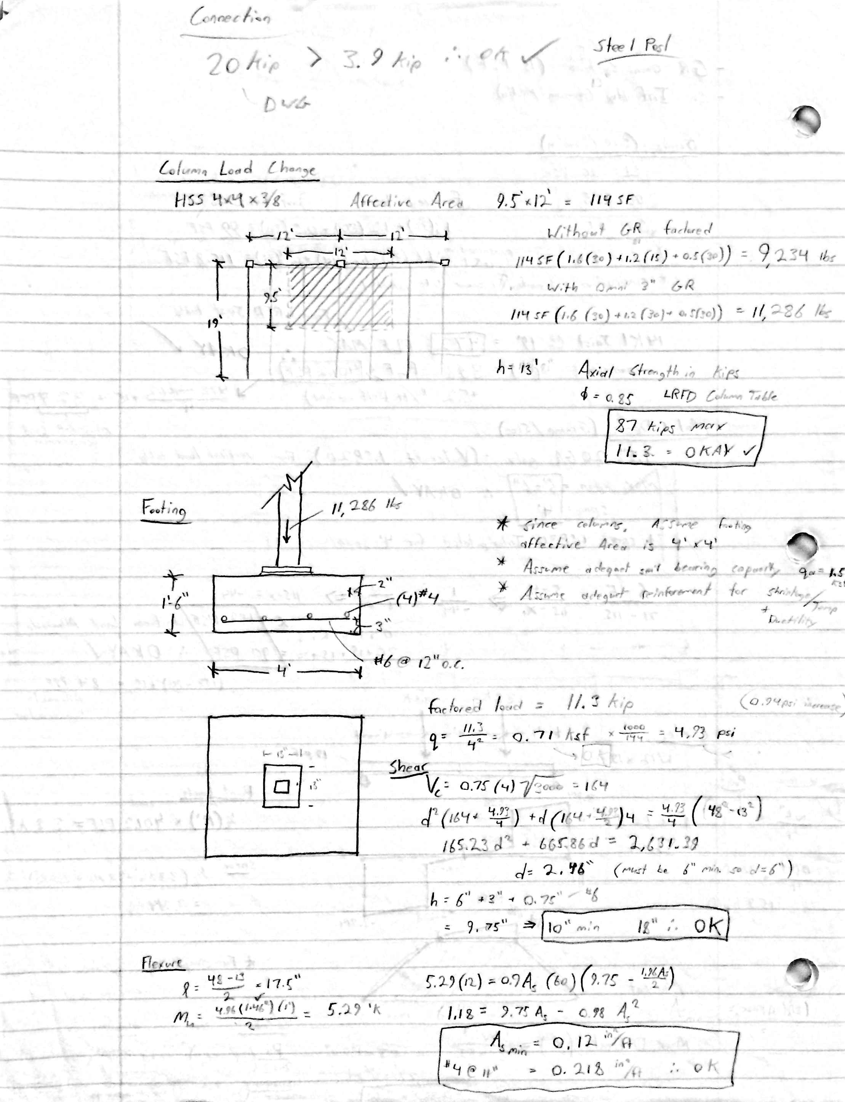
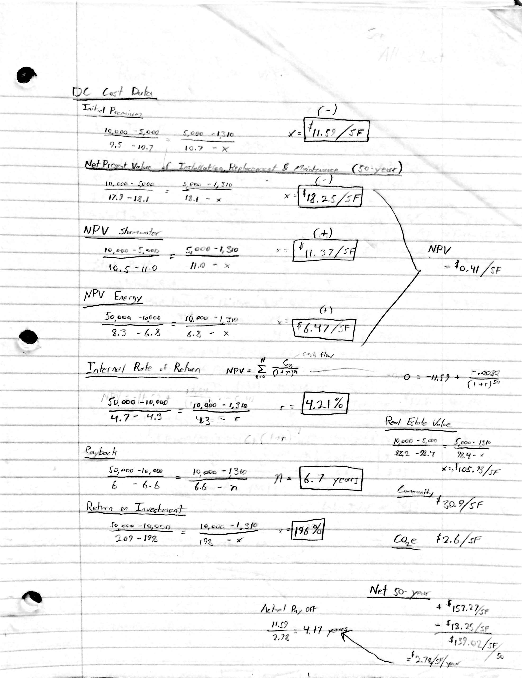
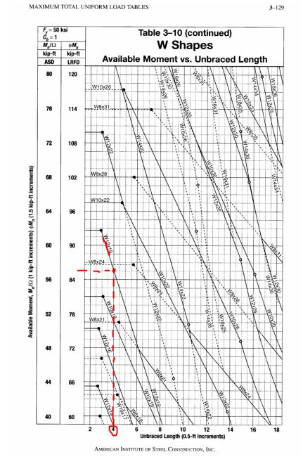
Appendix
Taylor Hall – George Mason University
Fairfax, VA
Taylor Hall – George Mason University
Fairfax, VA
Bradley Williams - CM
Introduction
Prevention Through Design
Façade Re-design for PtD
Stick-Built vs. Infinity System
Green Roof Addition
Conclusion
Acknowledgments

Slide 14
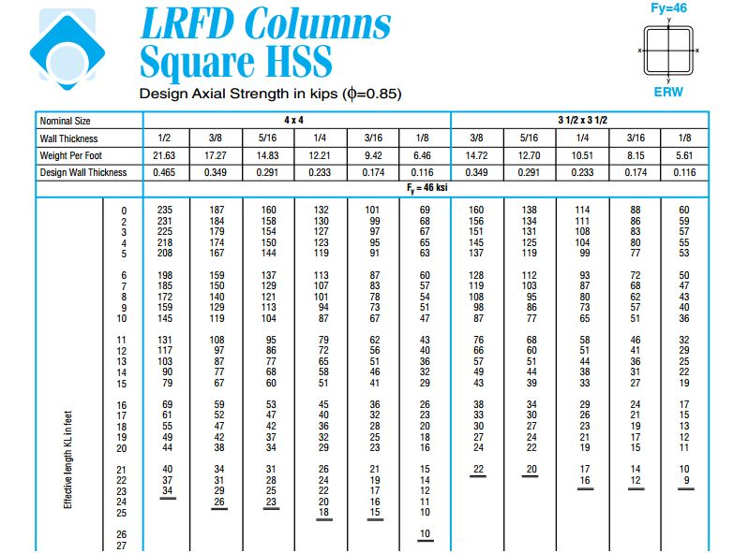
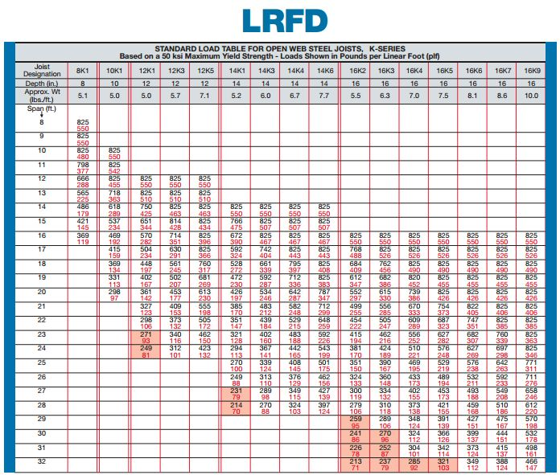
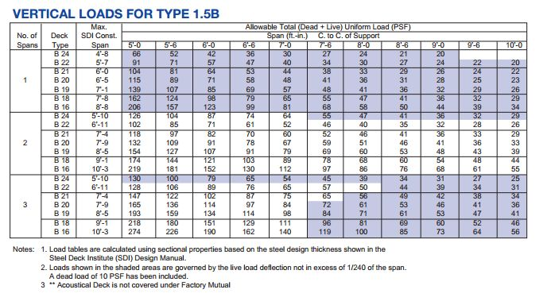
Appendix
Taylor Hall – George Mason University
Fairfax, VA
Taylor Hall – George Mason University
Fairfax, VA
Bradley Williams - CM
Introduction
Prevention Through Design
Façade Re-design for PtD
Stick-Built vs. Infinity System
Green Roof Addition
Conclusion
Acknowledgments

Slide 15
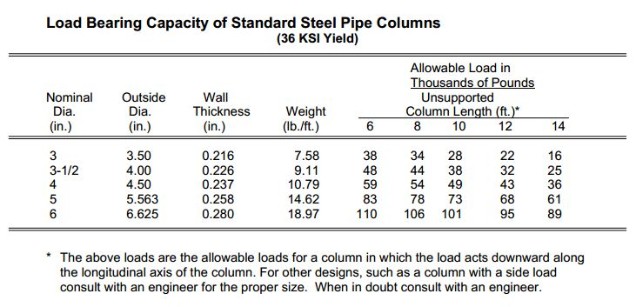
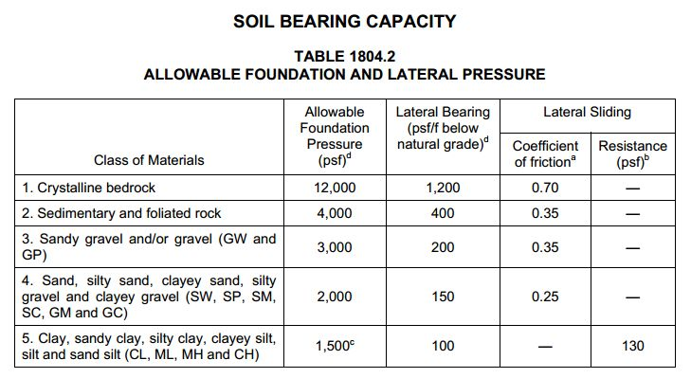
Appendix
Taylor Hall – George Mason University
Fairfax, VA
Taylor Hall – George Mason University
Fairfax, VA
Bradley Williams - CM
Introduction
Prevention Through Design
Façade Re-design for PtD
Stick-Built vs. Infinity System
Green Roof Addition
Conclusion
Acknowledgments

Slide 16
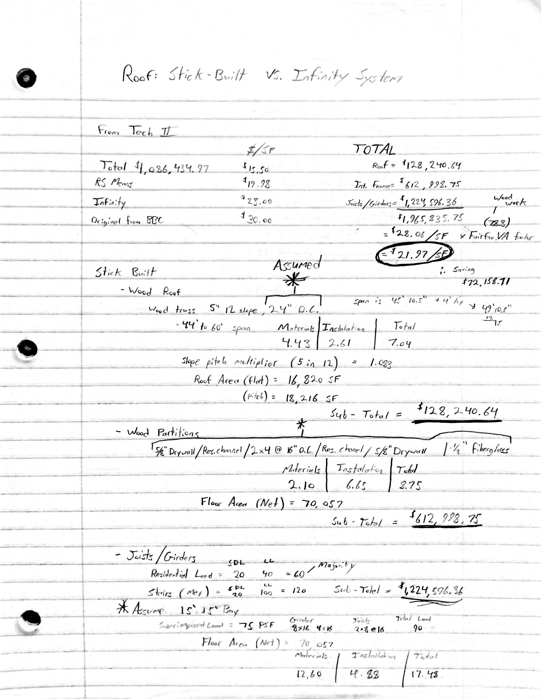
Appendix
Taylor Hall – George Mason University
Fairfax, VA
Taylor Hall – George Mason University
Fairfax, VA
Bradley Williams - CM
Introduction
Prevention Through Design
Façade Re-design for PtD
Stick-Built vs. Infinity System
Green Roof Addition
Conclusion
Acknowledgments

